Slide 1



While testing the PIM we noticed the following points, which we ask you to correct or improve
Prioritization of the individual point
High =
Medium =
Low =

Slide 2
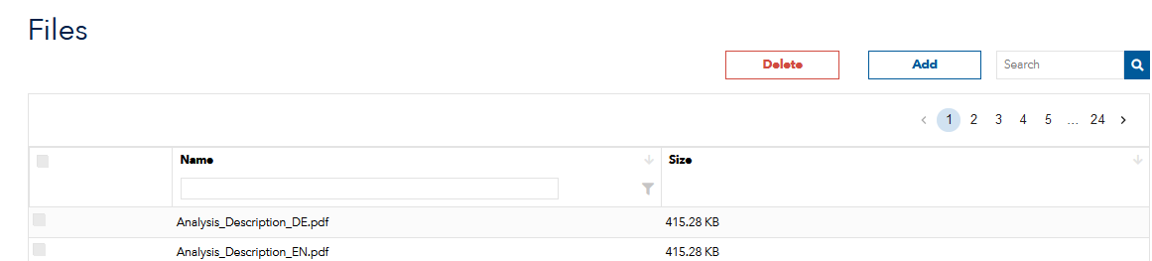
Admin area
Files
- We need to be able to open uploaded documents from the database, to be able to look into them, e.g. if you have to delete them.

Slide 3
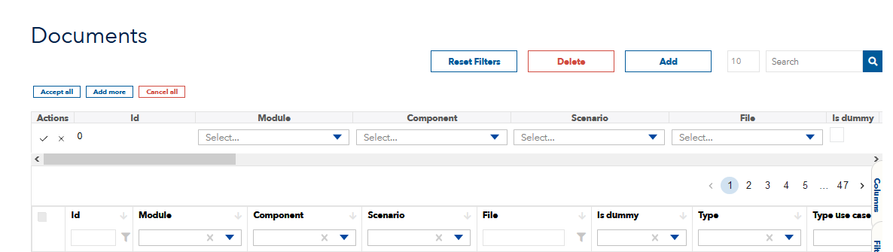
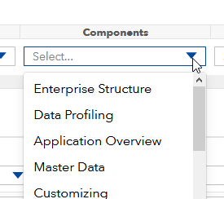
Admin area
Documents
- Please remove the language Russian from the PIM and hide the language Chinese.
Russian will not be used and Chinese will be used later. As long as there is no document set, the language should not be selectable in the dropdown menu
Please allow to change the column size in the maintenance view
Please create a possibility to select all values on one time in a drop-down menu.
For the components there is e.g. a document with FAQ which has to be assigned to all 29 components.
For example
→ select all ←

Slide 4
Admin area
Documents
Since the column must first be embedded in the default view, it is not possible to make subsequent adjustments in Abbreviation.
Please create the possibility for corrections here
We want to add another column to the document table where keywords can be maintained
? (We need the possibility to create more document types) ?
Please set up the possibility to upload videos (should always be possible).
Please set up the possibility to upload documents and other files that are not related to elements of the period system.
-> These files should then only be retrievable/accessible via the extended detail area

Slide 5
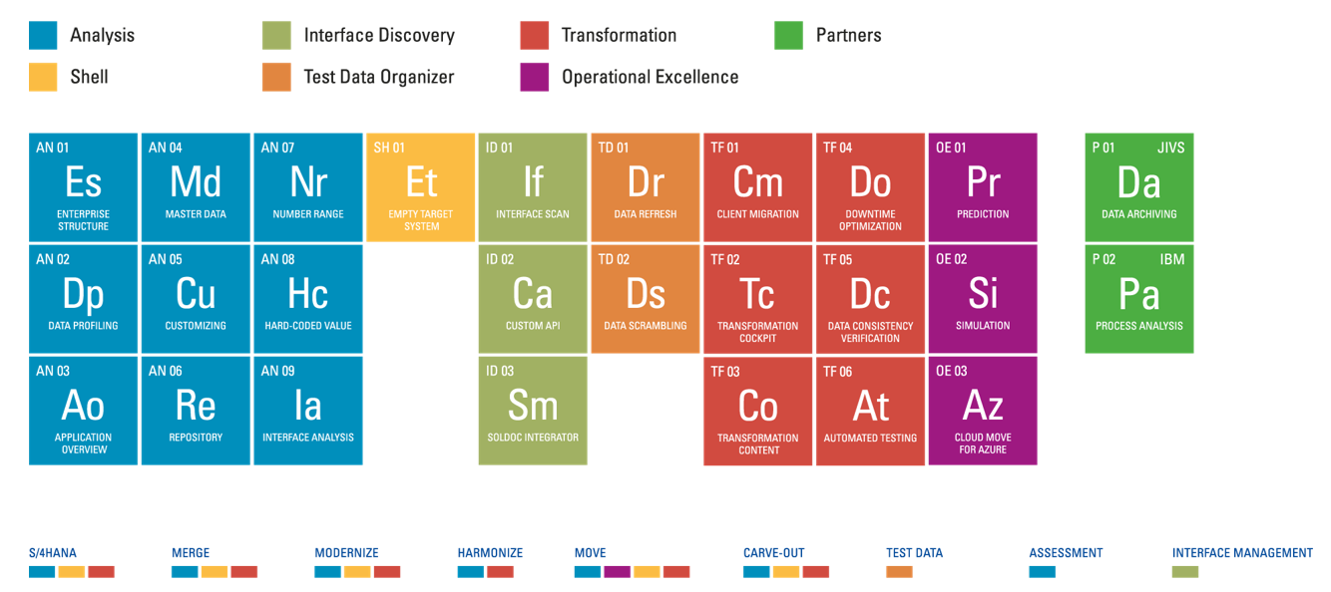
PIM UI area
General
Please implement the new design for the PIM
Modules
Componetns
Scenarios

Slide 6
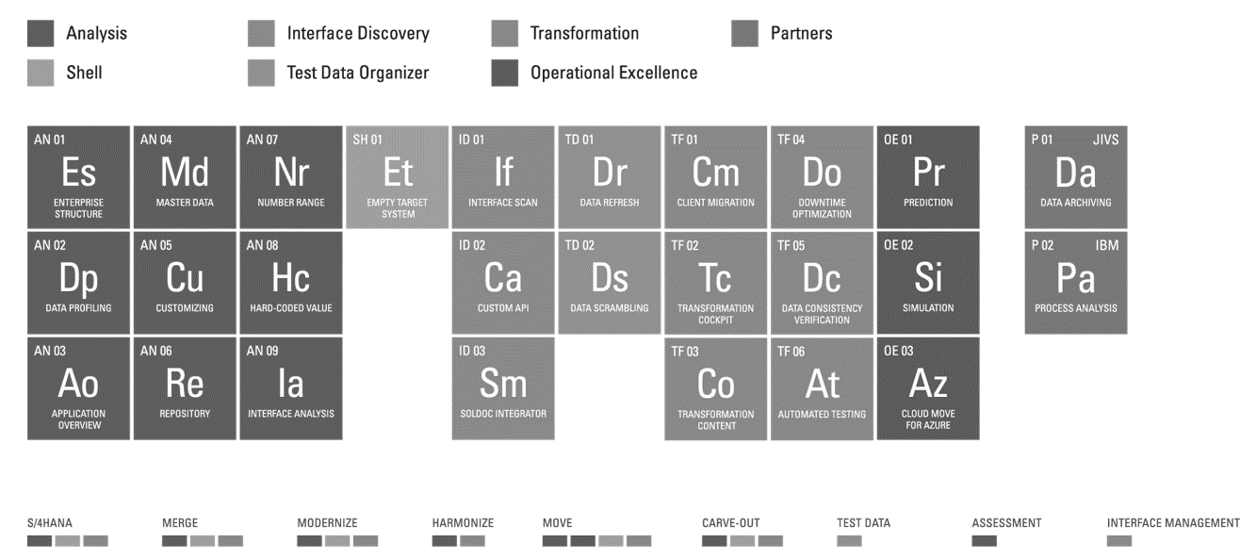

PIM UI area
General
All elements should be framed with a box when hovering the mouse over them. The function should be the same as for the elements in the Partner Portal
We need three more elements in module form:
one for Bluefield
one for CrystalBridge Platform
and one for Other SNP Categories
These should be listed similarly to the mission control -> here 3 more elements shall open (unfold) one of them will be selected
Crystal Bridge Plattform
Mission Control
Other SNP Categories
Non-Transformation Reseller Services
As a result, the respective documents should be provided in the detail view (just like in all other elements of the periodic table)

Slide 7
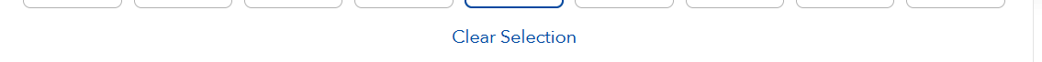
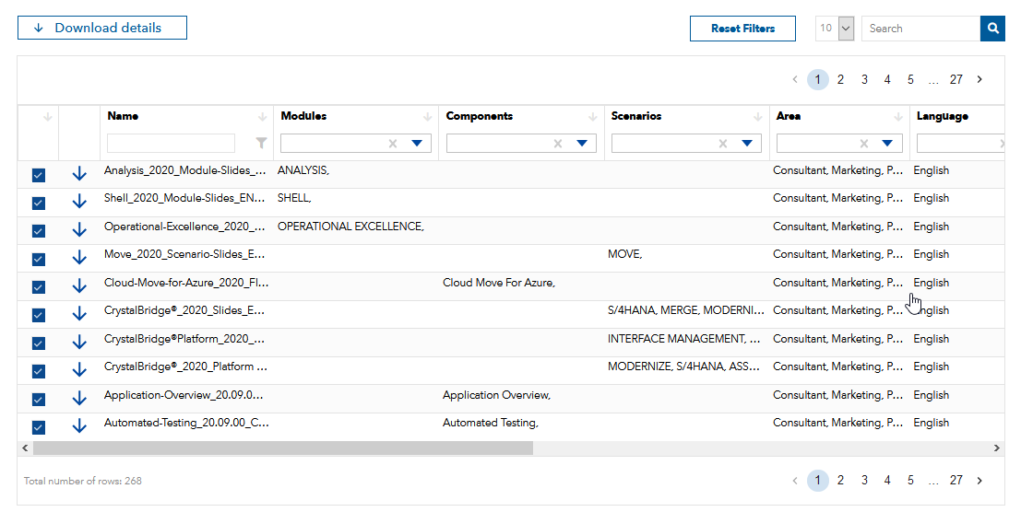
PIM UI area - Detailed area
Detail search
Please hide the following columns in the detail view:
-> Type-Use Case
-> Is dummy
Please include a "Deselect all" function in Reset-Filter & Clear-Selection.
If a scenario has been selected, the corresponding documents will be selected in the detail area. That’s fine!
The selection (the checkboxes) stay selected, but you have to deselect them individually if you want to have a single document.
Problem, some scenarios contain many documents .

Slide 8
PIM UI area - Detailed area
Detail search
Please hide the following columns in the detail view:
-> Type-Use Case
-> Is dummy
Please include a "Deselect all" function in Reset-Filter & Clear-Selection.
If a scenario has been selected, the corresponding documents will be selected in the detail area. That’s fine!
The selection (the checkboxes) stay selected, but you have to deselect them individually if you want to have a single document.
Problem, some scenarios contain many documents .

Slide 10
PIM Structure
In addition to the transformation business must be added:
NON-Transformation Business
Reseller
Services
-> Details see structure excel
The structure shown must be transported to the appropriate applications for the orchestra project
-> Details see orchestra slides
Add mandatory attributes in the structure for the connection to SAP
-> Details see orchestra slides & excel

Slide 12



Admin area
Files
- We must be able to upload and manage documents ourselves. We must be able to assign, delete and modify them and their entries.
- We need to be able to open uploaded documents from the database, to be able to look into them, e.g. if you have to delete them.
- PowerPoint presentations cannot be uploaded (it does not work for pptx & potx)

Slide 13

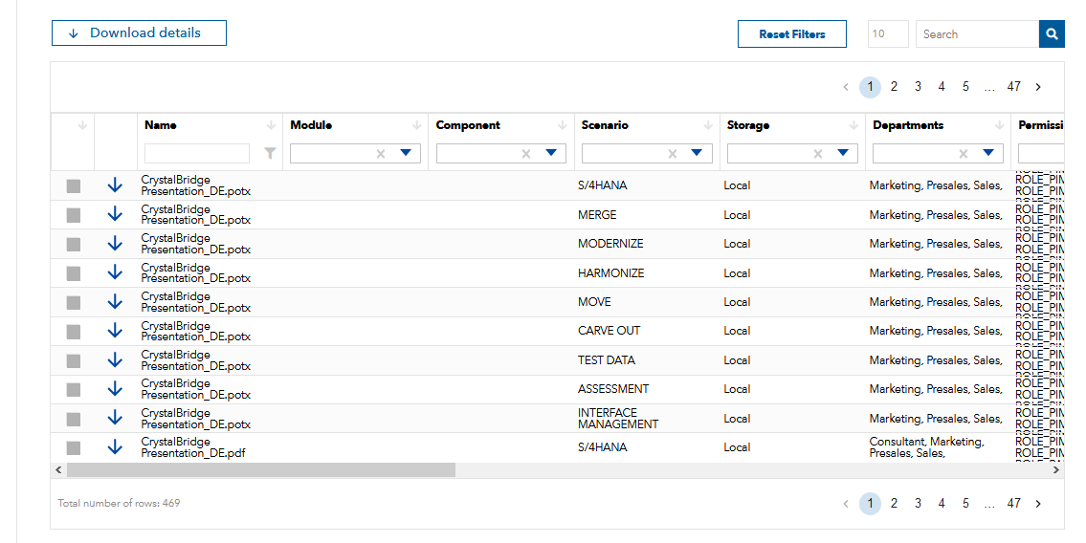
PIM area
Detail search
- We also need a scrollbar above => A different solution was realized

Slide 14
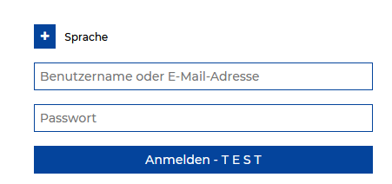
General
CrystalBridge
T E S T is still written on the CrystalBridge registration screen (in German version).
All current users present in the CrystalBridge must be assigned the PIM role.
The internal SNP users should have access to all existing documents → role PIM_ALL
In the past, the following e-mail traffic existed between Kamila and Julius:
Hi Jana,
There is a requirement from PIM team to give access to this application to all current and future CrystalBridge internal snp users.
To make it possible, we need to assign new role ROLE_PIM_INTERNAL to internal users and make sure that it will be assigned to all new ones.
Is it possible to do? When could we do that?
Best regards,
Kamila Malanowicz
The assignment can be done as part of a deployment script. It can be assigned to users with an snpgroup.com or snp-ag.com email address. This will cover a majority of the internal users.
Other internal emails (bccgroup, innoplexia, adepcon) can be set on a case-by-case basis since most of these are old/disabled accounts.
Going forward, Jana and I can assign the role as part of the basic internal role set.
Best regards,
Julius Flores
→ Please implement this topic in such a way that all internal users are enabled and have the same possibilities as the role PIM_ALL,
that means all internal users should have the possibility to access all available documents.
The popup for the cookie hint when using the Chrome browser should be shown again by a new login.
If possible it should be shown until the user's cookie settings have been adjusted. The popup is too short to read and implement the popup informations.

Slide 15
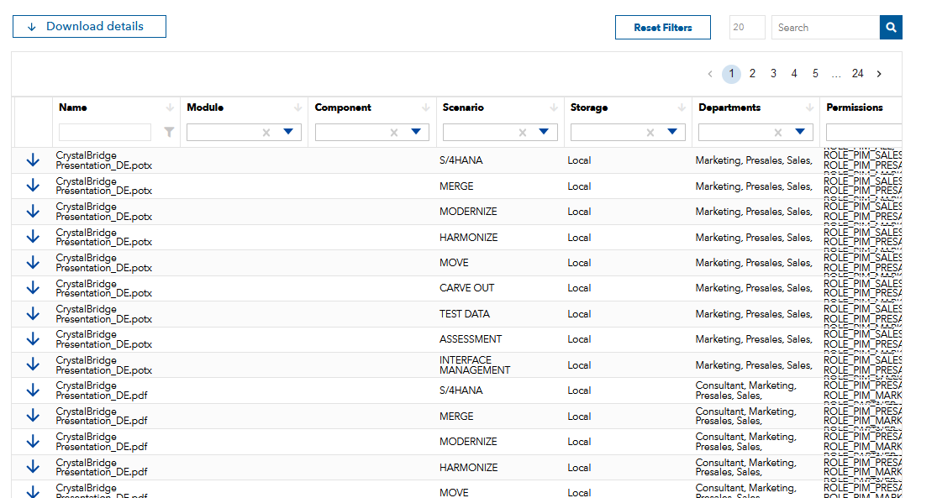
PIM area
Detail search
Each document should only appear once in the list, all assignments and other attributes should always be entered on the same line, so that a document is only displayed once.
However, the entries must still be readable. the display in the column perissions, for example, would not be a suitable solution.

Slide 16
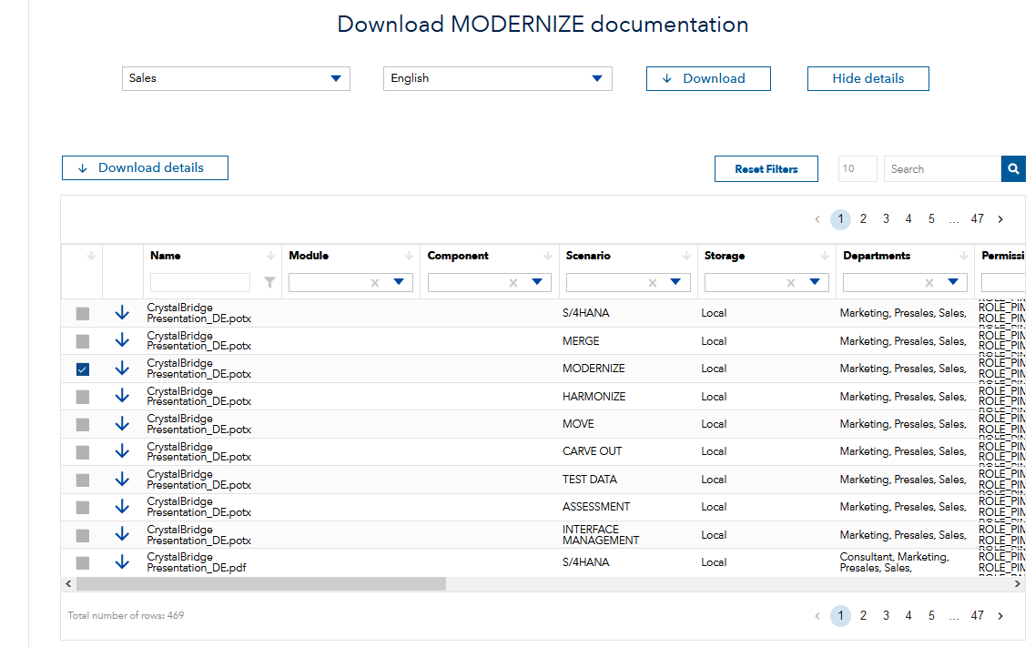
PIM area
Detail search
When selecting a scenario, the display in the details area must be set so, that the first column automatically shows all documents selected above
→ Sorting by raked and unraked
The department and language information must be included in the detailed selection
→ In the detail area you have to show exactly what is packed with the selected scenario, module or component above, also for download
The column "departments" must be renamed to "area”
In the detail view, the following columns must be hidden for normal users: Storage / Permission / File / Document owner

Slide 17
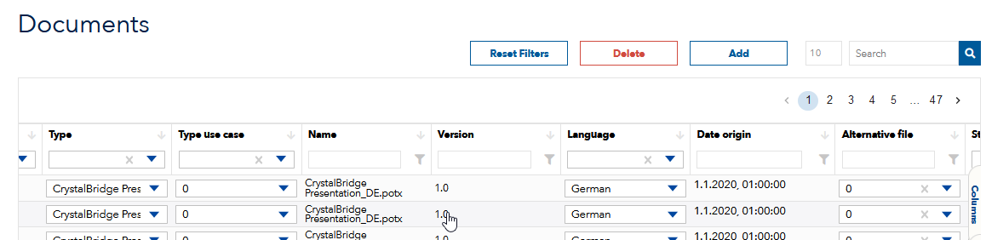
Admin area
Documents
- The name in the column name must be generated automatically from the document/file name
If you make a mistake when entering a new data set, the entries you made are gone afterwards, and you have to repeat everything.
This is very impractical if you have just entered several documents. Here, please design in such a way that you have the possibility to correct errors
There must be the possibility to remove a value (so that it is 0 again). If you have selected an item from a dropdown list, it cannot be undone

Slide 18
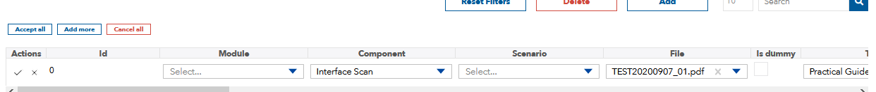
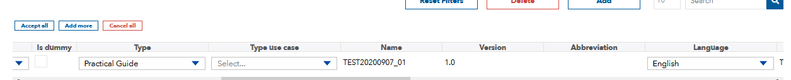
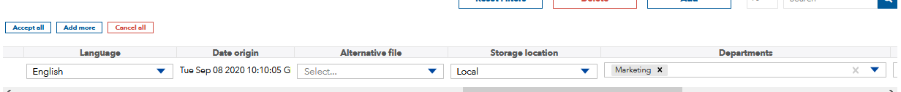
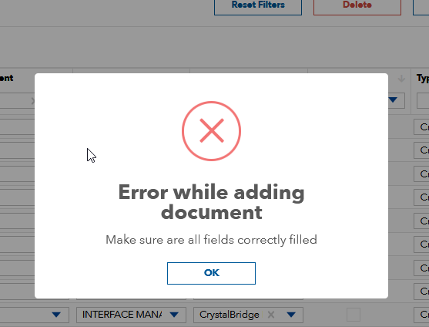
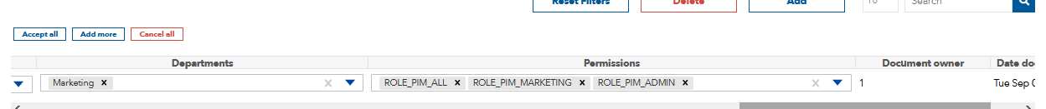

Admin area
Documents
- If you want to create the record of the documents the error shown below appears. In the pictures you can see what we have entered in our test.
Later it is also not possible to download the document in combination with a scenario selection.
It is only possible to download a single document with the blue arrow symbol in the detail area.
We have also tried to generate the entries by adding ".pdf" after the name. Adam said in the past that this was necessary because the name and the file name including the ending have to be are exactly the same. This did not work either.
By the way:
If this is still mandatory, this should be changed, because the name in a database is normally without file extension and can be designed in any shape for an entry.

